Slide 1
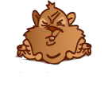
Whack a mole
Press ‘c’ to start
brought to you by the BDM lab

Slide 2
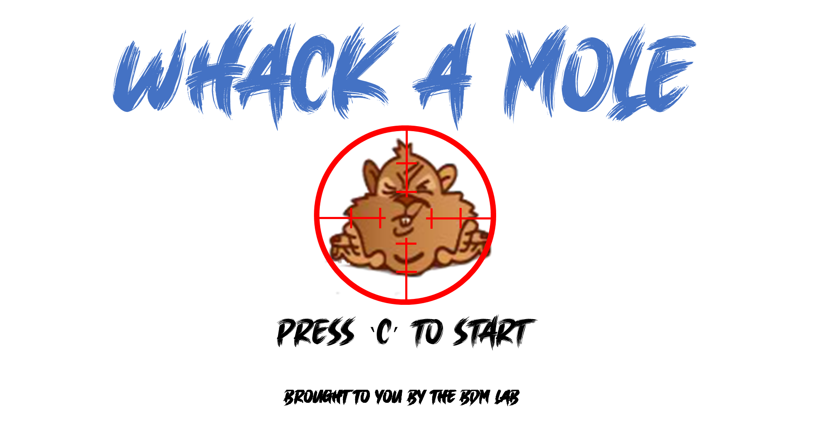
Notes:
8 by 2 the correct size

